Slide 1
Python Project
Remote density vs Company evaluation
Jungu Kang

Slide 2
Index
Objective – Remote Density vs Company Evaluation
Data from Indeed.com
Method
Code: Web Scraping with BeautifulSoup
Code: Analysis with Pandas
Result
Conclusion
Feedback
QnA

Slide 3
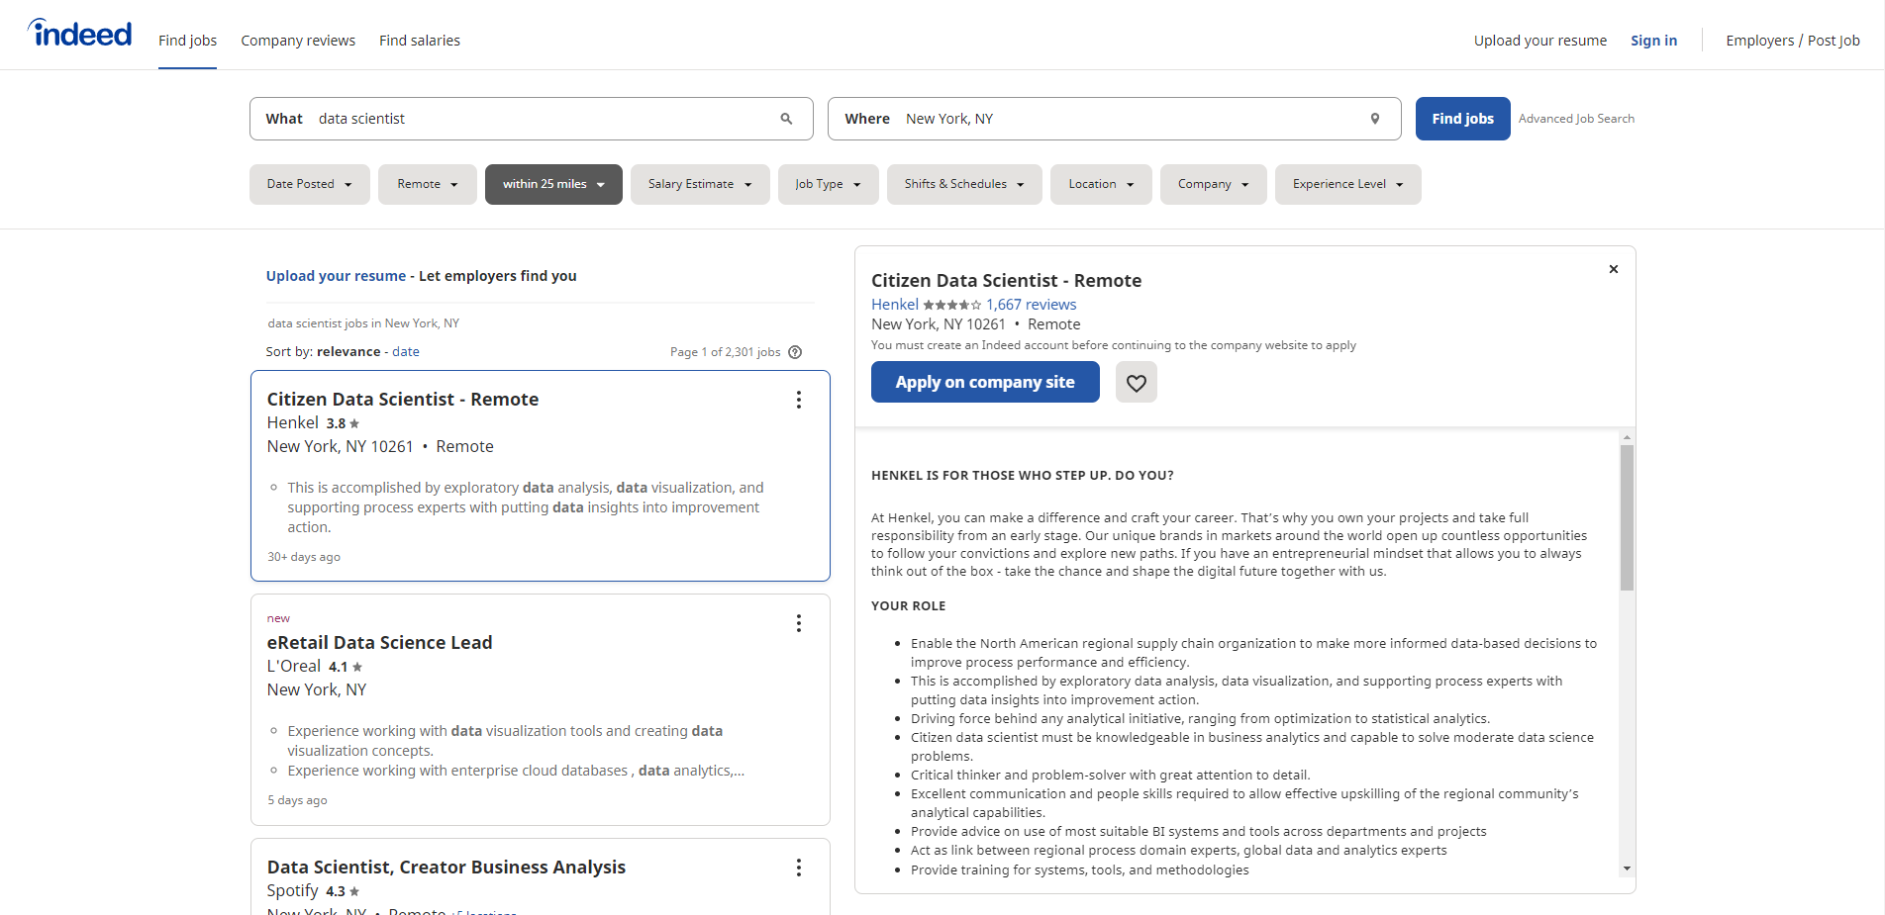
Objective – Job search
@ Indeed.com search as
Field: Data Scientist
Location: New York, NY
What can we get?
Job title, Company,
Rate, Location, Remote
Problem?
Too many result pages.
Interested in remote job.

Slide 4
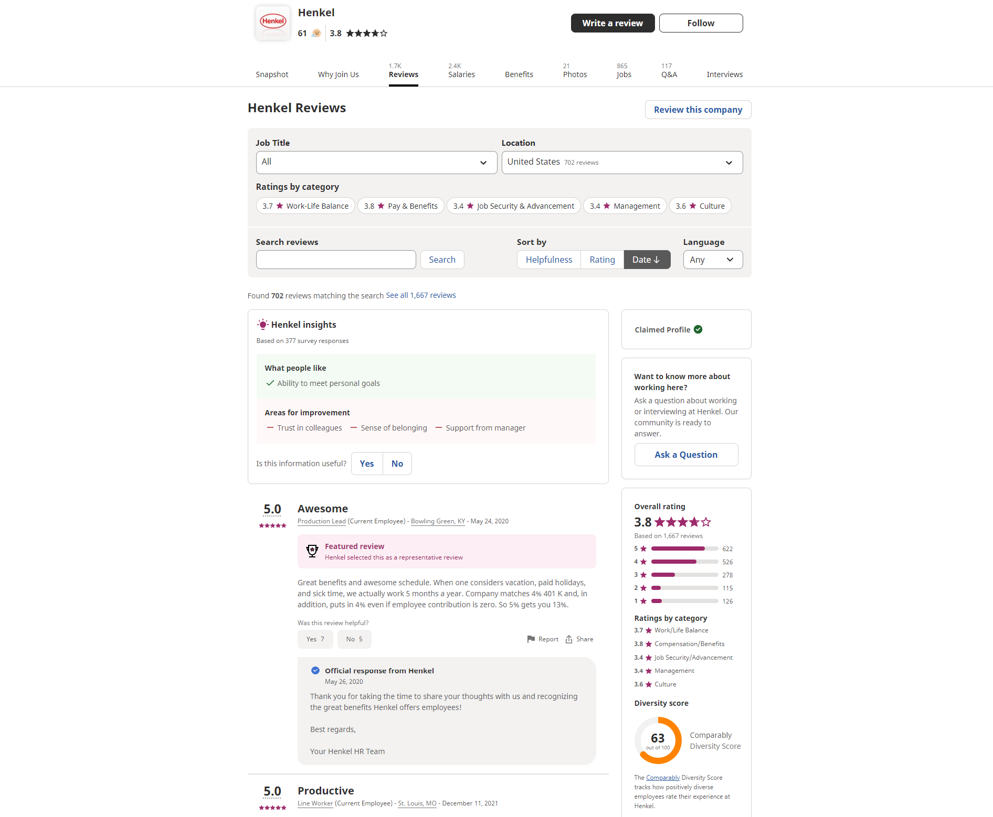
Objective – Remote Density vs Evaluation
Web Scraping the indeed search results and the company pages in indeed for detail company’s evaluation such as count per stars for rate or salary satisfaction
Will there be any relationship between how people evaluate the company and the remote density?
Remote Density = Opened as remote / Total
* Terms of Service was checked for web scraping

Slide 5
Code – Web Scraping
Web scraping with BeautifulSoup
Code flow
Get initial search result url per input; field and location
Save job information from each card, usually for 15 companies per page
Repeat for the next search result for each input
Get each company’s indeed webpage url
Save interested company evaluation information, rate and salary satisfaction
Total 2 datasets
One for job information, the other one for company evaluation
Be careful, you can be trapped by reCAPTCHA. Make sure you include time sleep function to avoid it

Slide 6
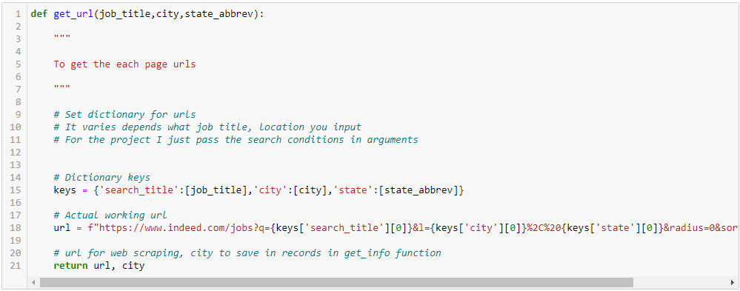
Detail code

Slide 7
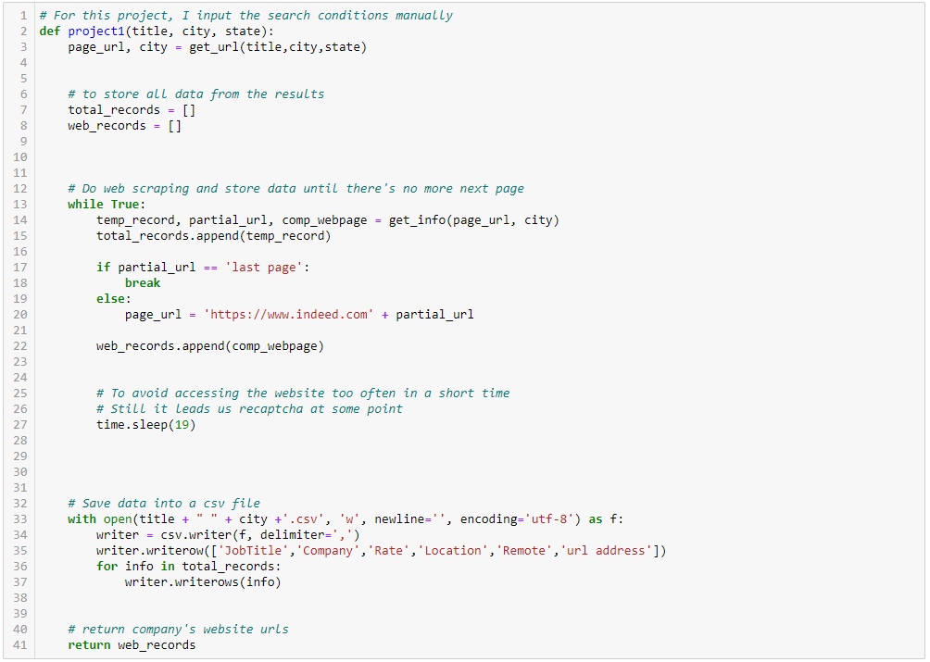
Detail code

Slide 8
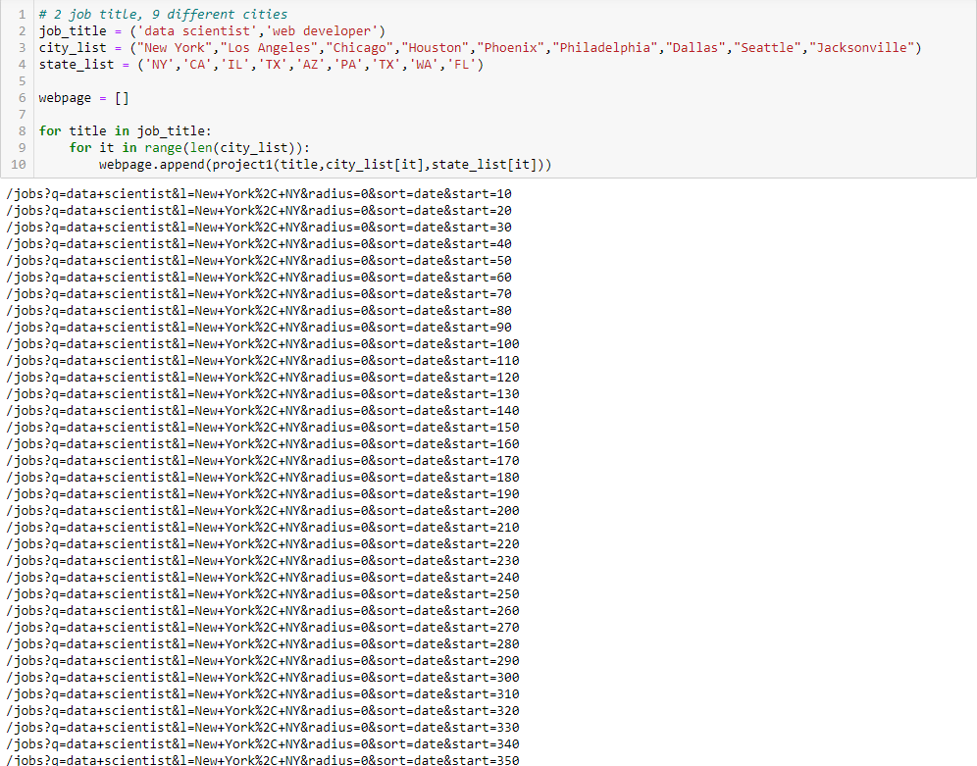

Slide 9
Code – Data Analysis
Data Analysis with Pandas
Code flow
Get two tables for each dataset, job information and company information
Adjust format such as K -> 1,000, removing % symbol
Join the tables
Analysis and plot

Slide 10
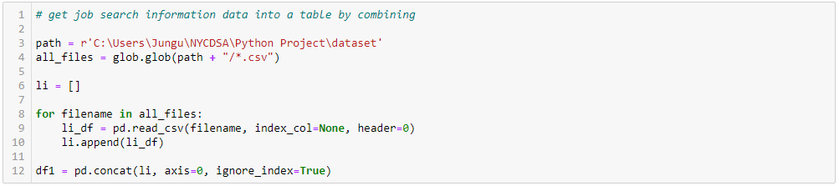
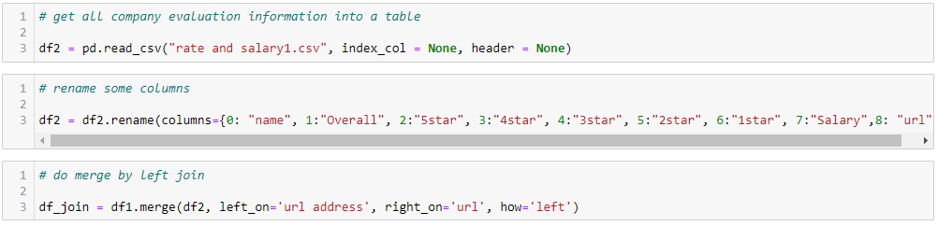
Detail code

Slide 11
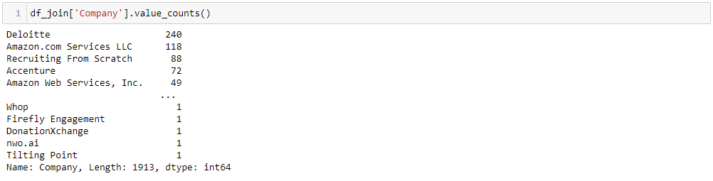

Slide 12
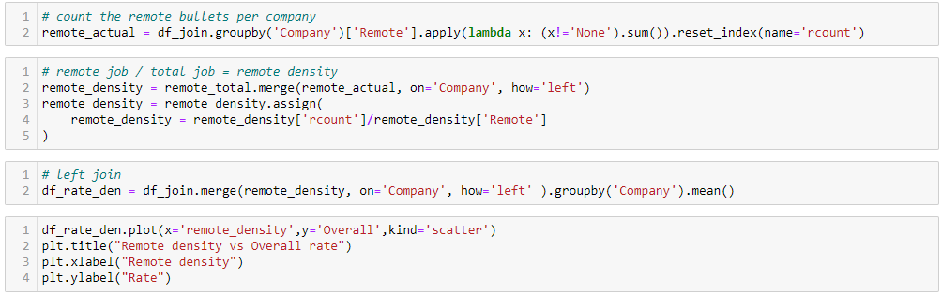
Detail code

Slide 13
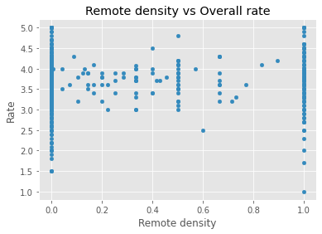
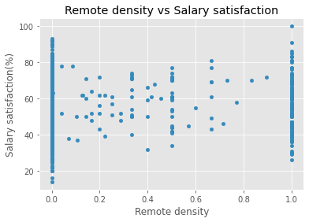
Code – Result
Plot with matplotlib - pyplot

Slide 14
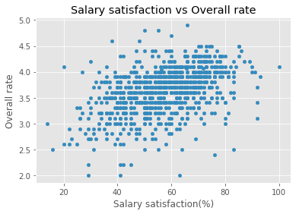
Code – Result
Plot with matplotlib - pyplot

Slide 15
Conclusion
There’s no strong evidence that remote density is important to companies’ evaluation by eye-test.
It is difficult to see an obvious relationship between remote density and overall rate, or between remote density and salary satisfaction.
Many of them have remote density as 1 or 0.
This is because about a half of the companies post only 1 job.
If those companies post the job as remote, the density is 1, if it’s not a remote then the density is 0.
There is a positive relationship between salary satisfaction and overall rate.

Slide 16
feedback
Need more samples to get more accurate result. This result only includes ‘data scientist’ and ‘web developer’. Some remote job field such as ‘Accountant’ or ‘CAD designer’ can be added.
The rate is just for overall. The result may be different if the code could gather specified field rate. Overall rate has not only data scientist + web developer but also anyone works for the company. Different department may have different evaluation.

Slide 17
Questions?

